Slide 1

2022 Member Benefits Overview
1800 M Street, NW, Suite #400S, Washington, DC 20036 | Phone: (202) 530-9740 | info@gridwise.org | www.gridwise.org

Slide 2

About GridWise Alliance
  The GridWise Alliance leads a diverse membership of electricity industry stakeholders focused on accelerating innovation that delivers a more secure, reliable, resilient, and affordable grid to support decarbonization of the US economy.
Our Core Message:
A modern grid is the critical infrastructure component of a decarbonized advanced digital economy.
2022 Focus: Implement the Infrastructure Bill
  Impact how grid infrastructure funding is implemented within states.
  Engage state policymakers and regulators through increased coordination with NASEO/NARUC on overarching state needs.
  Activate industry leaders to inform their understanding of the changes taking place to the grid.

Slide 3
2022 Board of Directors
Gil Quiniones, Chair
CEO, ComEd
Lisa Barton, Vice Chair
Executive Vice President and Chief Operating Officer, American Electric Power (AEP)
Larry Bekkedahl, Director
Vice President of Grid Architecture, Integration & System Operations, Portland General Electric (PGE)
Steve Callahan, Director
Executive Vice President, GridBright
Connie Carden, Director
Managing Director - Energy and Utilities Vertical, EY
Neil Gerber, Director
Industry Executive Director, Utilities, Oracle
Chris Guttman-McCabe, Director
Chief Regulatory and Communications Officer, Anterix
John Haysbert, Director
Vice President, Government and Institutional Relations, Hitachi ABB Power Grids
Giri Iyer, Director
Vice President, Business Development, Sentient Energy
Katie Jereza, Director
Vice President of External Relations and Communications, EPRI
Kerrick Johnson, Director
Vice President Strategic Innovation, VELCO
Lee Krevat, Director
Founder and CEO, Krevat Energy Solutions
Jay Lasseter, Director
Senior Vice President Industry + Growth, Landis + Gyr
Peter Muhoro, Director
Chief Strategy, Technology & Innovation Officer, Rappahannock Electric Cooperative
Dan Pfeiffer, Director
Vice President of Government Affairs, Itron
Randy Pryor, Director
Vice President, Distribution Projects and Grid Modernization, CenterPoint Energy
Mahesh Sudhakaran, Director
General Manager, IBM Energy, Environment & Utilities, IBM
Michele Tihami, Director
Chief Revenue Officer, Electriq Power
Wade Troxell, Director
Board Member, Platte River Power Authority
Robert Wilhite, Director
Senior Vice President and Director, Global Distributed Energy, Black & Veatch
Joshua Wong, Director
CEO, Opus One Solutions
Rudy Wynter, Director
President, National Grid NY

Slide 4
2022 Priority Initiative:
Grid Investments through the Implementation of the Infrastructure Investment and Jobs Act (IIJA)
Engaging with Federal and State agencies as they develop funding strategies
  Department of Energy (DOE), Department of Transportation (DOT), National Telecommunications and Information Administration (NTIA)
  Working group responses to RFIs, NOIs, FOAs, etc…
  Highlighting thought leadership of members
Deepen interaction with organizations representing state officials
  Workshops with and presentations to National Association of State Energy Officials (NASEO) and the National Association of Regulatory Utility Commissioners (NARUC).

Slide 5
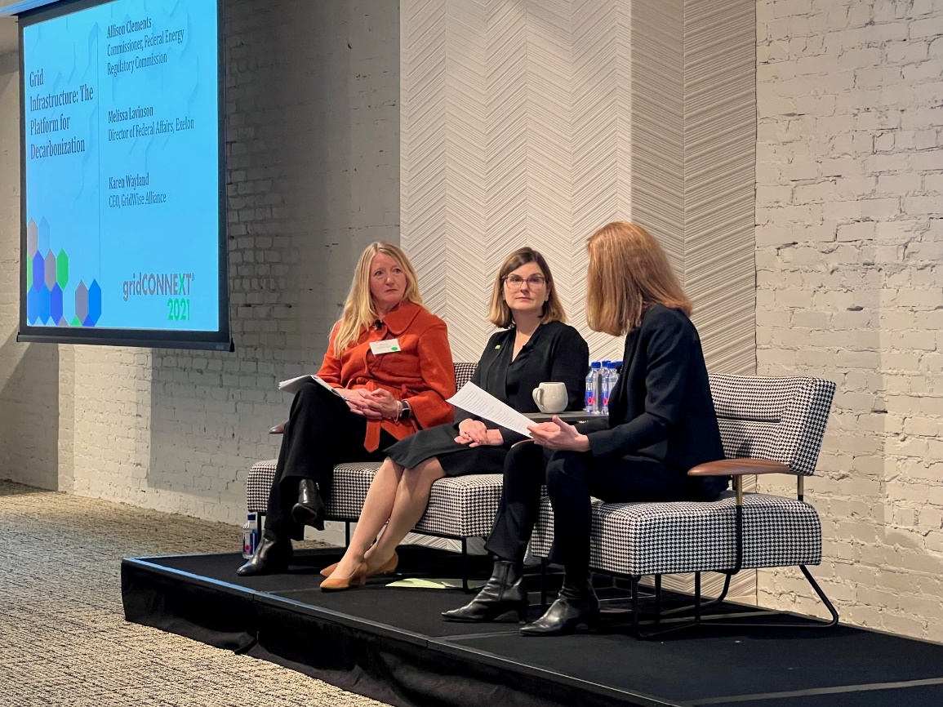
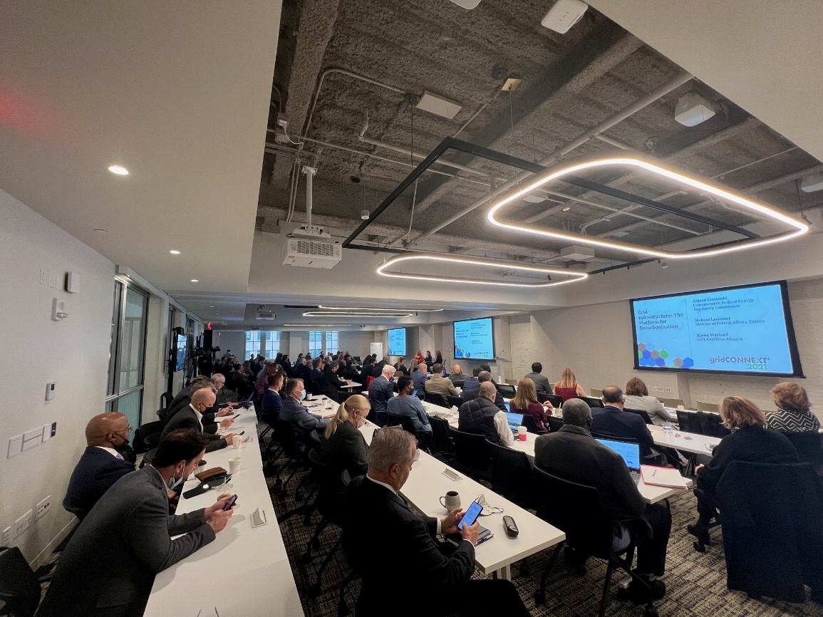
Membership Value
The GridWise Alliance:
is a UNIQUE VOICE that drives impactful change
INFORMS POLICY by amplifying members’ interests
CONVENES industry thought leaders
facilitates PEER-TO-PEER INFORMATION SHARING that shapes the nation’s grid modernization agenda
HIGHLIGHTS MEMBERS’ work and showcases its positive impact to customers and to our country

Slide 6
Realizing Member Benefits in 2022
Member Engagement Opportunities
Policy Council Meetings
Quarterly themes, with deep dives into subtopics. Responding to current policy trends and issues.
Q1 2022
Workforce
Technology Council Meetings
Supporting expansion of the GridWise Technology Portfolio.
Q1 2022
Electric Vehicles
Grid Investments Task Force
Weekly meetings for members to discuss implementation of the IIJA through engagement with federal agencies.
Ad Hoc Working Groups
Short- or long-term groups formed based on needs. For example, to respond to agency RFIs or questions from policymakers.
Connect us with your marketing teams
So GridWise messages reach more stakeholders, and we are more aware of your activities.

Slide 7

2022 Themes – Quarterly Focus
Q1 Theme: Workforce
January – Transmission and Distribution Employment Report
February – Labor Union perspective
March - TBD
How Themes Direct Our Activities
Policy Council Meetings: bring other perspectives to our members
Topical Focused Newsletter Content: supports alignment of messaging
Member Profiles on website: promotes member voices
Industry Focused/Hill Focused Educational Webinars: to spotlight our members
Op-Eds and primers on key topics: to inform industry & members
Goals Within
Each Theme
Highlight efforts of GridWise Alliance members
Elevate the voice of GridWise Alliance
Develop new partnerships and strengthen existing ones
Engage new members
each month

Slide 8
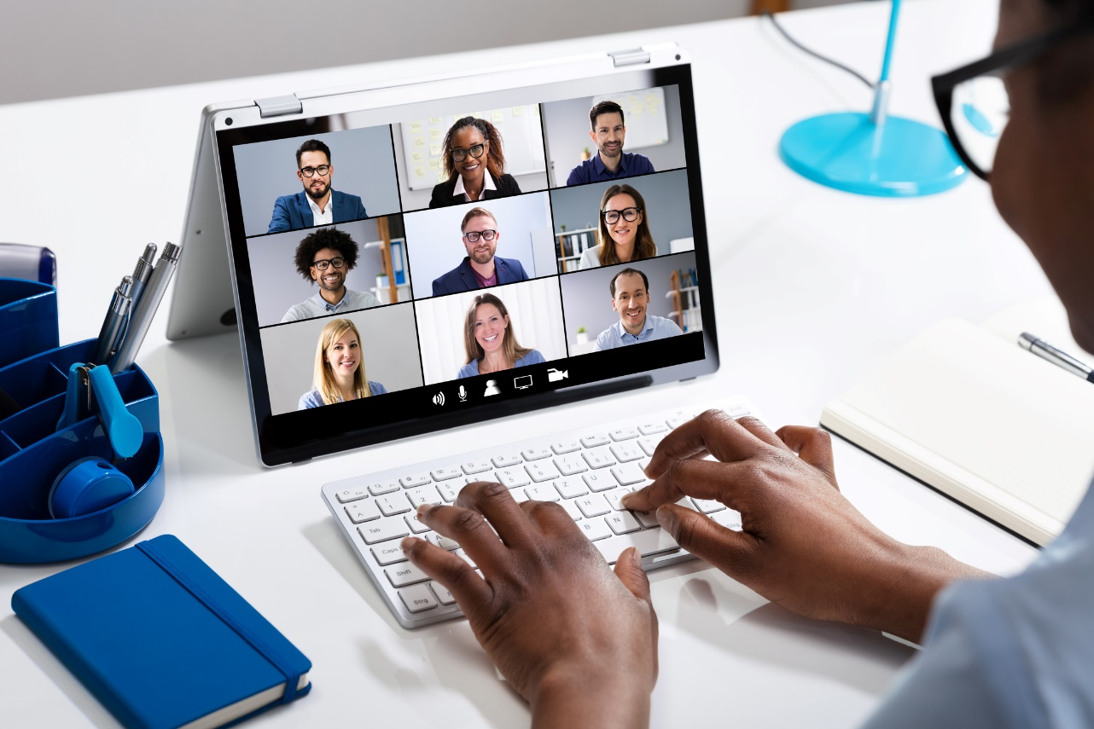
GridWise Member Meetings 2022
Grid Investment Task Force
– Every Tuesday morning
– 11:00 AM ET / 8:00 AM PT
Policy Council
– 2nd Wednesday of the month
– 3:00 PM ET / 12:00 PM PT
Technology Council
– 4th Wednesday of the month
– 3:00 PM ET / 12:00 PM PT

Slide 9


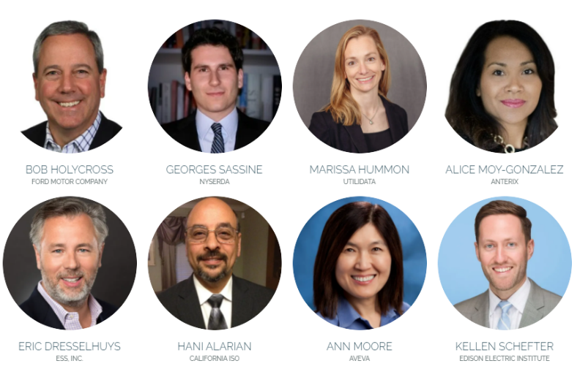

ENGAGE
Grid Infrastructure: The Platform for Decarbonization
gridCONNEXT 2022
Washington DC
TBD

Slide 10
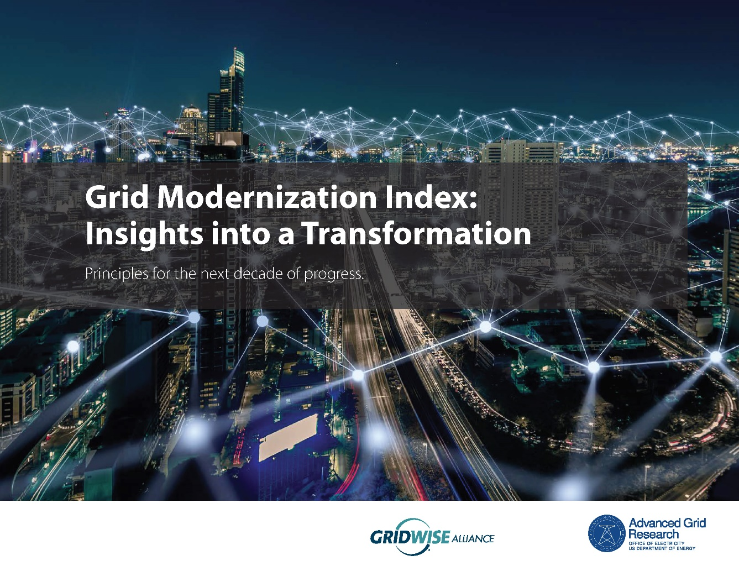
Grid Modernization Index Report
INFORM
GMI Insights into a Transformation report released November 3, 2020
Download the Report Here or at www.gridwise.org
GridWise interviewed utilities to document the successes of several first-movers across the country and highlight the common principles that will drive real change in the decade ahead.
We hypothesized a report full of resounding success stories, instead the resulting conversations highlighted how important the process of change is to the greater goal.
In the report, we explore five guiding principles:
  Launch a formal change management process.
  Focus on collaboration.
  Create a culture of innovation.
  Embrace the digital transformation.
  Develop the future workforce.

Slide 11

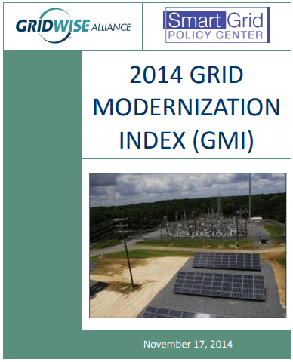
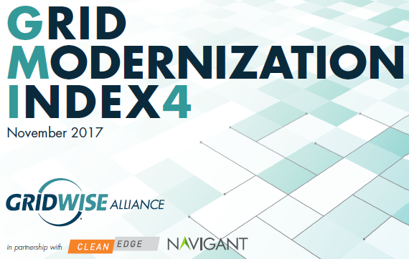
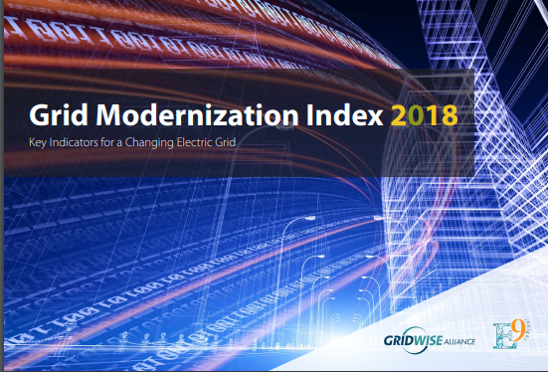

Grid Modernization Index
INFORM
The GridWise Alliance’s Grid Modernization Index (GMI) uses data inputs and publicly-available information to evaluate and rank the status of grid modernization efforts across all 50 states and the District of Columbia.
Coming in 2022 GMI Readiness Report: Do we know if states are ready to reach decarbonization goals through electrification?
  A collaborative evolution of the Grid Modernization Index that clearly articulates what needs to be done to achieve decarbonization goals and categorizes states based on GridWise’s definition of their readiness to do so.

Slide 12

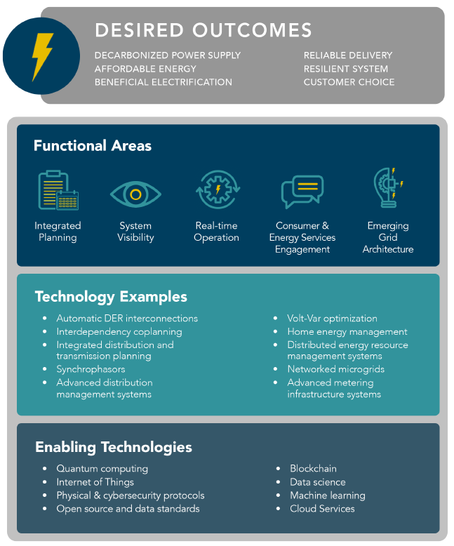
Technology Portfolio
AMPLIFY
Download the report here
or at gridwise.org

Slide 13

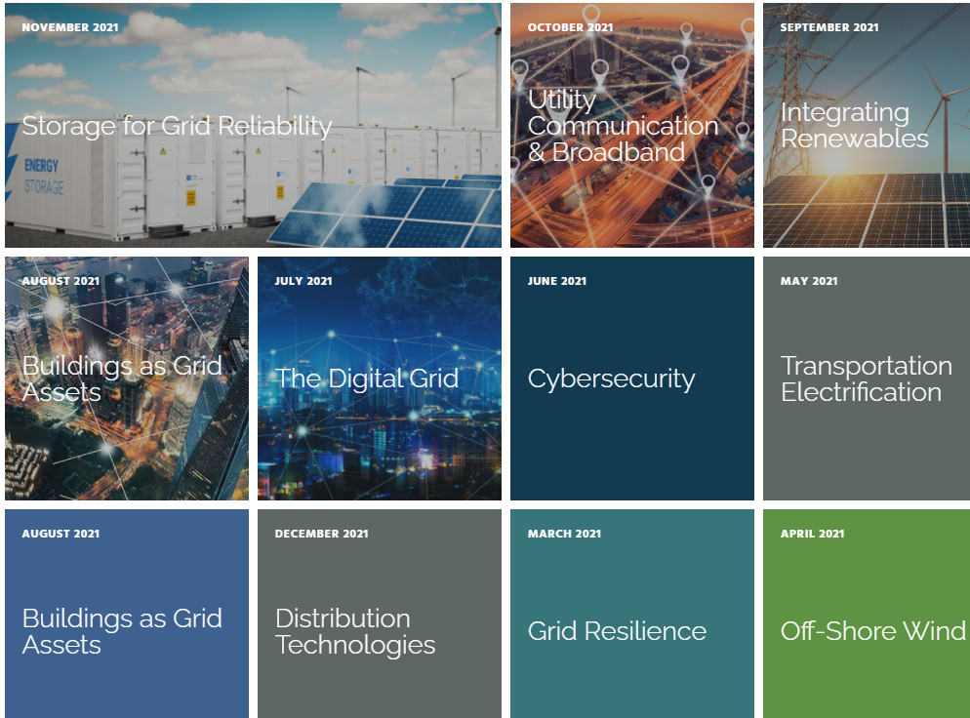
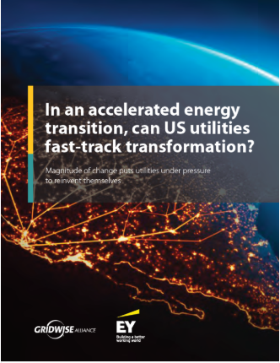
Thought Leadership on Key Issues
ACTIVATE
  Convening industry stakeholders around grid related topics.

Slide 14
Membership Structure
Type | Eligibility | Revenue Level | Dues Amount | Benefits
Full Membership | Any business entity that operates within North America, and supports the vision, mission and activities of the Corporation shall be eligible to apply to become a Full Member of the Corporation. Designated representatives of Full Members are eligible to serve on the Board of Directors and the Nominating Committee, vote for Directors, join Work Groups, and participate fully in Corporation activities. | <$10M in Annual Revenue $10M to $100M $100 M to $1B >$1B in Annual Revenue Rural Electric Cooperatives | $3,000.00 $7,500.00 $15,000.00 $20,000.00 $3,000.00 | Board of Directors Eligibility Voting Membership Website access Project Team/Working Group Participation Member Newsletters Policy Updates Stakeholder Forums Update Webinars
Affiliate Membership | Any college, university, or other similar entity not eligible to become a Full Member or Associate Member, as determined by the Board of Directors, that supports the vision, mission and activities of the Corporation shall be eligible to apply to become an Affiliate Member of the Corporation. Designated representatives of Affiliate Members are not eligible to serve on the Board of Directors but shall be eligible to vote for Directors or at meetings of the membership. Affiliate Members shall be join Work Groups and to participate in other activities of the Corporation. | N/A | $500.00 | Voting Membership Project Team/Working Group Participation Member Newsletters Policy Updates
Associate Membership | Any governmental entity, non-profit organization whose primary source of revenue is membership dues, or other similar entity not eligible to become a Full or Affiliate Member, subject to approval by the Board of Directors, that supports the vision, mission and activities of the Corporation, shall be eligible to apply to become an Associate Member of the Corporation. Designated representatives of Associate Members are not eligible to serve on the Board of Directors. Associate Members shall be eligible to vote for Directors, join Work Groups and participate in other activities of the Corporation. | <$10M in Annual Revenue $10M to $100M | $2,500.00 $5,000.00 | Voting Membership Website access Project Team/Working Group Participation Member Newsletters Policy Updates Stakeholder Forums Update Webinars
For additional information, please contact K. Malaika Walton at (202) 495-3126 / mwalton@gridwise.org.

