Slide 1

2021 Annual Meeting of the Members
8:00am – 8:45am - December 9, 2021
Ensuring America’s Electricity Grid Supports our Economy's Changing Needs
1800 M Street, NW, Suite #400S, Washington, DC 20036 | Phone: (202) 530-9740 | Fax: 202-530-0659 | info@gridwise.org

Slide 2
Meeting Agenda
Welcome and Introductions New Members 2022-2023 Board of Directors | Karen Wayland, CEO | 8:00 – 8:05 (all times EST)
Update to Core Message and Value Prop | K. Malaika Walton, Membership and Programs Director | 8:05 – 8:10 AM
Highlights from 2021 | Aurora Edington, Policy Director Richie O’Neill, Executive Director Josh Steinhardt, Operations Director | 8:10 – 8:15 AM
GridWise Member Feedback | All | 8:15 – 8:30 AM
Questions and Answers | Group Discussion | 8:30 – 8:45 AM

Slide 3














New Members Growing Our Collective Voice
Notes:
New members logos on page
15 new members in 2021 – confirm correct?
More than half those in last 3 months.
Utilize grid investments and DOE / NASEO engagement to increase membership in 2022

Slide 4
2022 Board of Directors
Executive Committee
John Haysbert, Director
Vice President, Government and Institutional Relations, Hitachi Energy
Giri Iyer
Vice President, Business Development, Sentient Energy
Katie Jereza, Director
Vice President of External Relations and Communications, EPRI
Kerrick Johnson, Director
Vice President Strategic Innovation, VELCO
Lee Krevat, Director
Founder and CEO, Krevat Energy Solutions
Jay Lasseter, Director
Senior Vice President Industry + Growth, Landis + Gyr
Dan Pfeiffer, Director
Vice President of Government Affairs, Itron
Randy Pryor, Director
Vice President, Distribution Projects and Grid Modernization, CenterPoint Energy
Mahesh Sudhakaran
Industry General Manager - IBM Energy, Environment & Utilities Industries, IBM
Michele Tihami, Director
Chief Revenue Officer, Electriq Power
Wade Troxell, Director
Board Member, Platte River Power Authority
Joshua Wong, Director
CEO, Opus One Solutions
Gil Quiniones, Chair
CEO, ComEd
Lisa Barton, Vice Chair
Executive Vice President and Chief Operating Officer, American Electric Power (AEP)
Robert Wilhite, Director
Senior Vice President and Director, Global Distributed Energy, Black & Veatch
Rudy Wynter, Director
President, National Grid NY
Larry Bekkedahl, Director
Vice President of Grid Architecture, Integration & System Operations, Portland General Electric (PGE)
Stephen Callahan
Executive Vice President, GridBright
Connie Carden, Director
Managing Director - Energy and Utilities Vertical, EY
Denise Galambos, Director
Vice President, Utility Oversight, Exelon Corporation
Neil Gerber, Director
Industry Executive Director, Utilities, Oracle
Chris Guttman-McCabe
Chief Regulatory and Communications Officer, Anterix
Notes:
Note we do not see David Koogler here, note his pending retirement!

Slide 5
Update to Vision and Value Proposition
Core Message
A modern grid is the critical infrastructure component of a decarbonized advanced economy.
What is The GridWise Alliance
The GridWise Alliance leads a diverse membership of electricity industry stakeholders focused on accelerating innovation that delivers a secure, reliable, resilient, and affordable grid to support decarbonization of the US economy.
Value Proposition Statements for 2022
The GridWise Alliance…
    Is a Unique Voice That Drives Impactful Change
    Informs Policy By Amplifying Members’ Interests
    Convenes Industry Thought Leaders
    Facilitates Peer-to-peer Information Sharing That Shapes The Nation’s Grid Modernization Agenda
    Highlights Members’ Work And Showcases Its Positive Impact To Customers And To Our Country
Notes:
Malaika to highlight new core message and value proposition statement, produced from Operations Committee, potentially with Lee Krevat

Slide 6
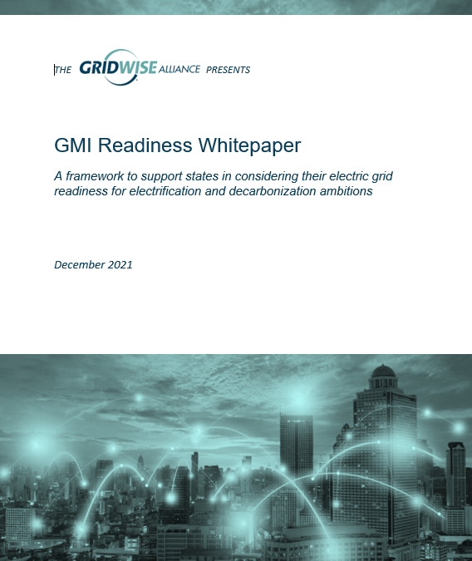
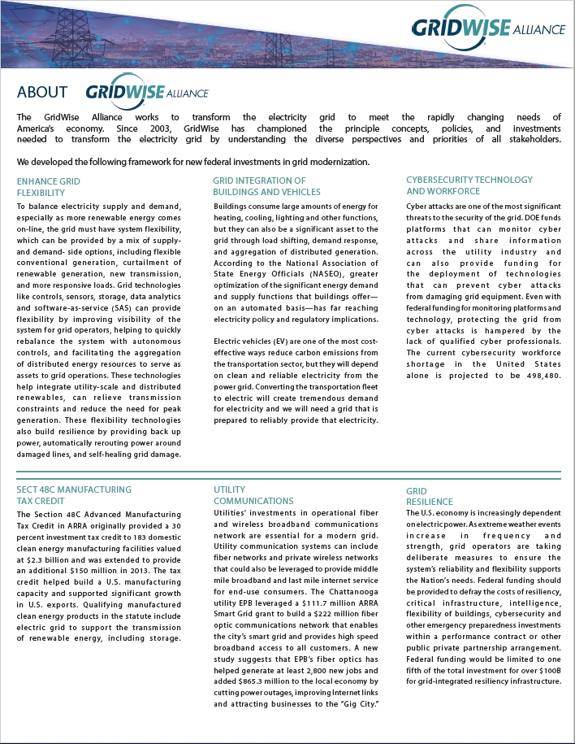
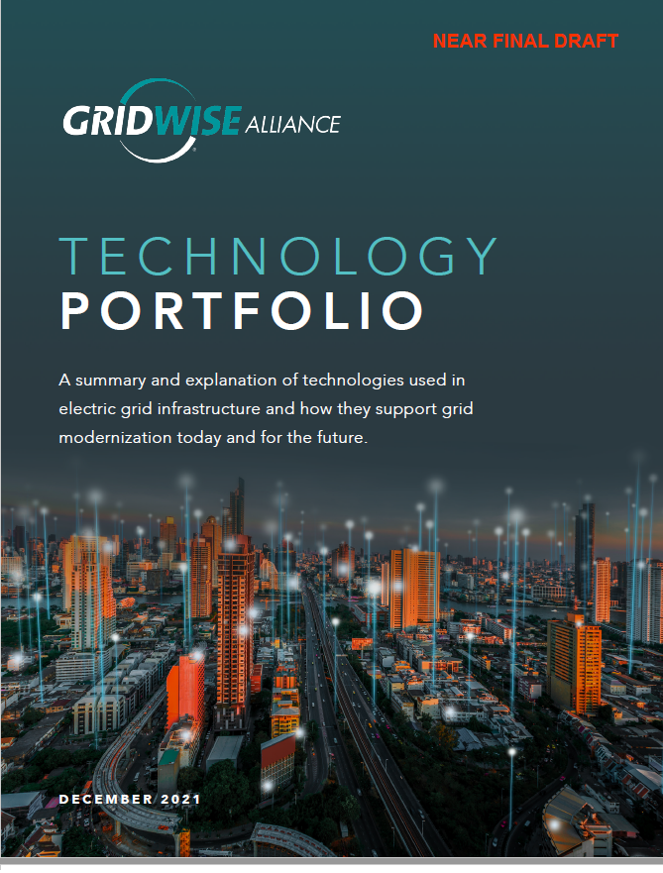
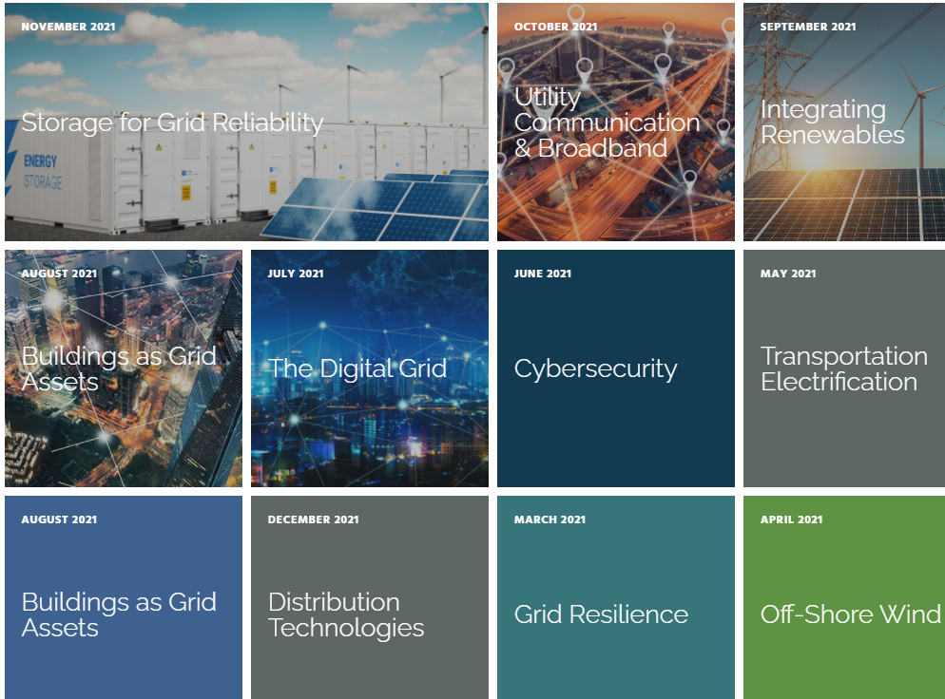
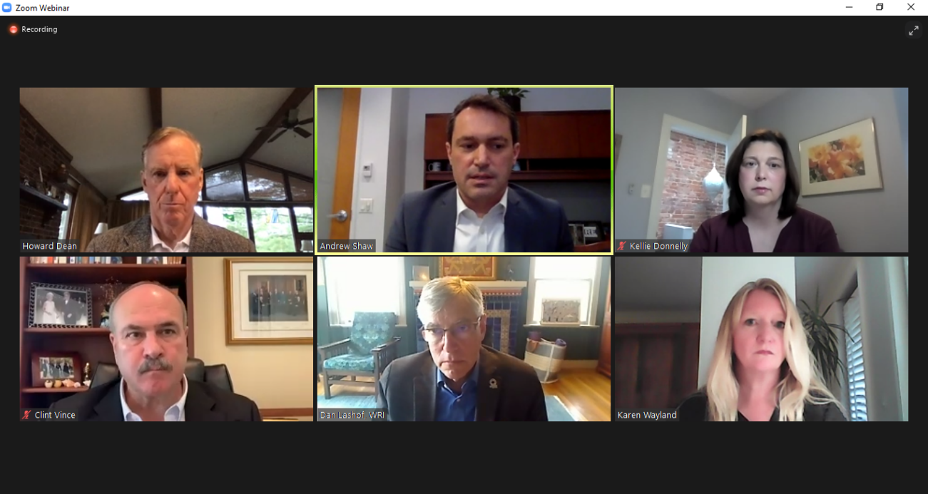
2021 Highlights
Notes:
Monthly Topical Themes
drove messaging / raised voice
Member Driven Reports
Technology Portfolio
Grid Modernization Index – Readiness Whitepaper
Policy Development
Building of grid investments framework
DOE issues and recommendations

Slide 7
Continuing to Engage Members in 2022
How Can You Provide and Gain Value from Engaging?
Join the Policy and Technology Councils
To provide a strong voice to Congress and the Biden Administration as we push for new federal funding and explore technology collaborations.
Promote GMI data collection efforts
To ensure that our analysis is representative of the changes taking place across all 50 states.
Participate in Technology Portfolio
To amplify your visions and articulate best practices
across the industry.
Utilize GridWise within your networks
To support your initiatives and improve our ability to provide value add opportunities.
Connect us with your broader teams
Bring in communications, policy, technology leads so GridWise messages reach more stakeholders.

Slide 8
Questions and Answers
As you look towards 2022, what are the top three issues of the grid industry you believe the GridWise Alliance should address?
Notes:
GWA Survey
Lead with a question to audience
OPEN Forum

